Slide 1

Empirical Evaluation of Gated Recurrent Neural Networks on Sequence Modeling

Slide 2
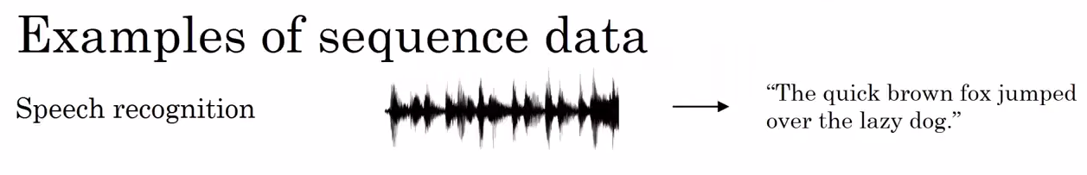
DNA sequence analysis, machine translation etc etc
The paper dealt with polyphonic music and raw speech datasets.

Slide 3
The Paper about ?
The paper compares
tanh RNN,
LSTM,
GRU.
for this particular dataset
GRU is better. WHY?
LSTM is found to be comparable to GRU. WHY?
LSTM and GRU outperform tanh RNN. (Rnn is Okeyish ) WHY?
WHY NOT STD NN?

Slide 4
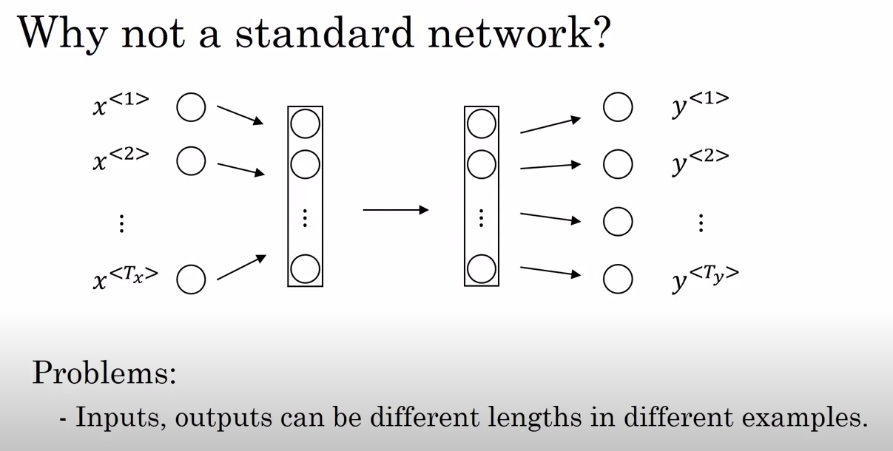
Each input represented as one hot representation vector

Slide 5
WHY RNN?
Solves STD NN problems

Slide 6
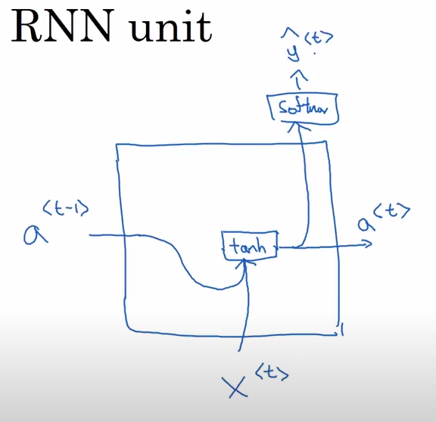

Slide 7
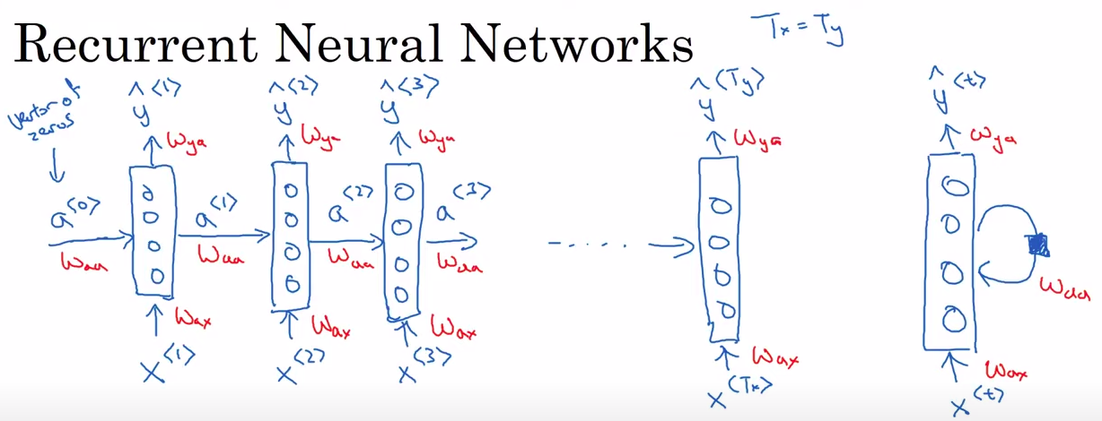
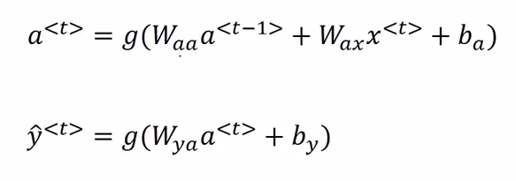

Slide 8
Weights and bias are shared across each step

Slide 9
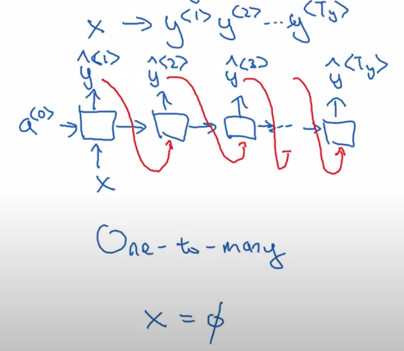
Music generation

Slide 10
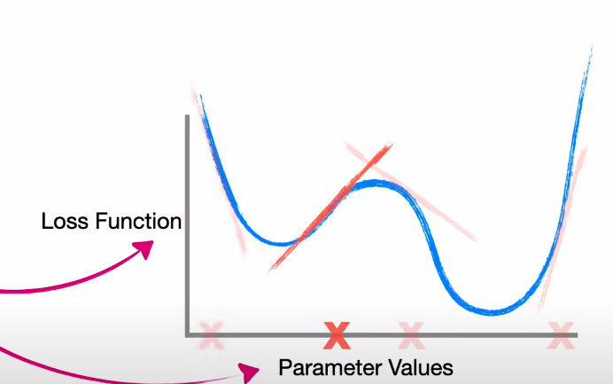
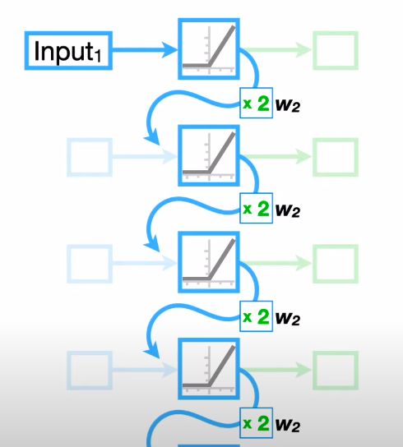
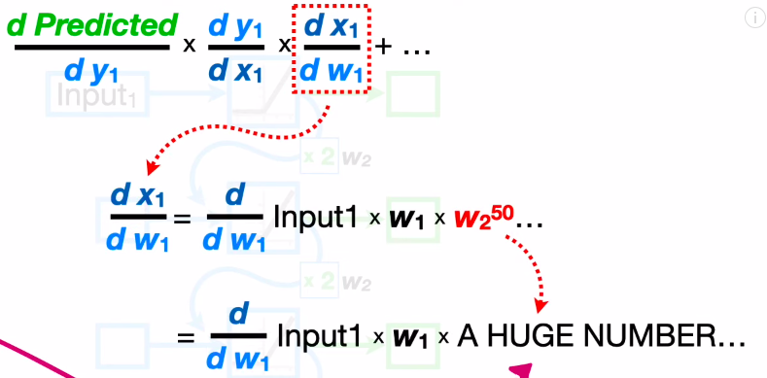
Weakness of RNN
Exploding Gradient (w>1) Problem:
Reference: https://youtu.be/AsNTP8Kwu80?feature=shared

Slide 11
Solution: Gradient clipping
look at our gradient vectors
if it is bigger than some threshold —---> rescale to below 1

Slide 12
Vanishing gradient problem
The cat which actually ate blah blah blah ……, was full
The cats which actually ate blah blah blah ……, were full
Prediction heavily influenced by short term memory rather than long term

Slide 13
Can’t we use gradient clipping for vanishing gradient?

Slide 14
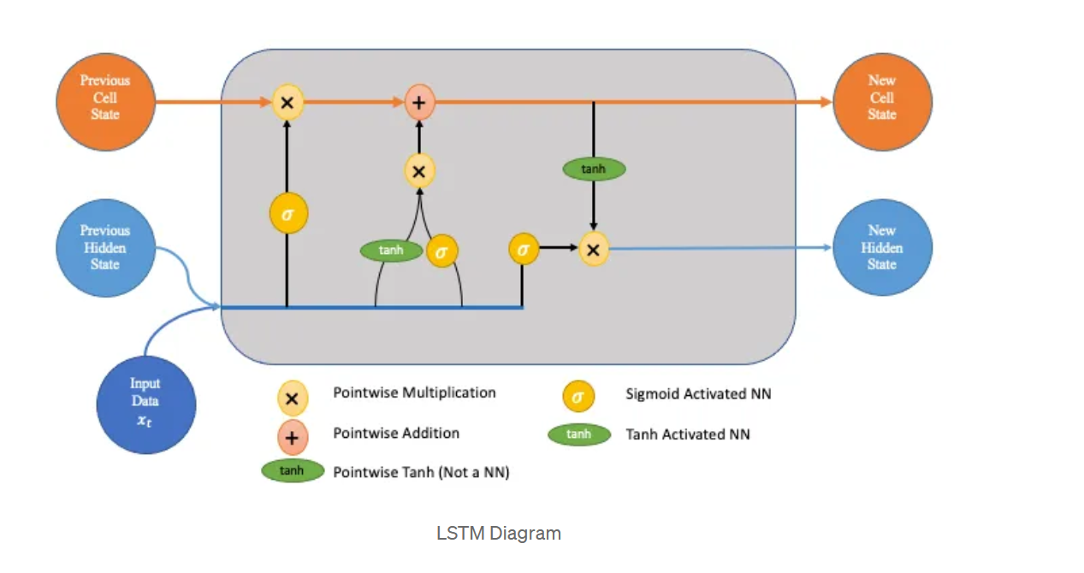
LSTM
Designed to overcome long-term dependency problem
LSTMs are good at processing sequences of data such as text, speech and general-time series
LSTM use series of gates to control how information comes into, stored in and leaves the network

Slide 15
GRU
GRUs are gating mechanism in recurrent neural networks
Similarly to the LSTM unit, the GRU has gating units that modulate the flow of information inside the unit
To solve the vanishing gradient problem of a standard RNN, GRU uses, so-called, update gate and reset gate
GRU eliminates the vanishing gradient problem since the model is not washing out the new input every single time but keeps the relevant information and passes it down to the next time steps of the network.

Slide 16
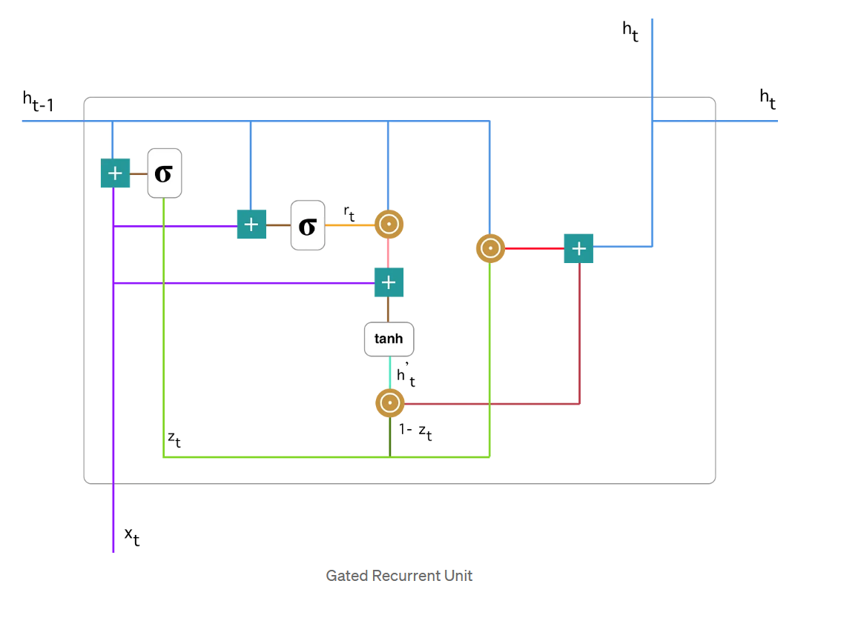
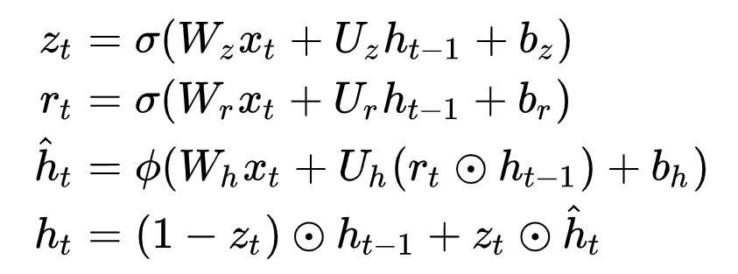

Slide 17
Similarities between LSTM and GRU
Both LSTM and GRU:
Are designed to capture long-term dependencies in data.
Use gating mechanisms to control the flow of information.
Address the vanishing gradient problem of tanh RNNs.

Slide 18
Difference between LSTM and GRU
Number of Gates:
LSTM: Three gates (forget, input, and output).
GRU: Two gates (update and reset).
Cell State
LSTM: Maintains a separate cell state in addition to the hidden state.
GRU: Combines the cell state and hidden state into a single state

Slide 19
Difference between LSTM and GRU
The LSTM unit controls the amount of memory content that is seen or used by other units in the network through the output gate, but GRU unit exposes its full memory content without any control.
The LSTM unit computes new memory content without a separate control for the information flow from the previous time step, but the GRU unit controls the information flow from the previous activation when computing the new candidate activation, but it doesn't independently control the amount of candidate activation being added.

Slide 20
Average Negative Log-Probabilities:
Log-Probability: The logarithm of a probability.
Transforms multiplicative operations into additive ones
computationally more stable.
Negative Log-Probability:
log(0 – 1)--> negative numbers
The above Log-Probability lie in this range
The negative of the log-probability is taken to make the values positive.
Average Negative Log-Probability:
This is average of the negative log-probabilities.
It's a measure of how well the model predicts the data on average.

Slide 21
Using Average Negative Log-Probabilities to Check Performance
Lower is Better: A lower average negative log-probability indicates that the model's predictions are closer to the true data distribution.
Comparison: By comparing the average negative log-probabilities of different models on the same dataset, we can determine which model predicts the data better. The model with the lower value is the better-performing one.
Overfitting: If the average negative log-probability on the training set is much lower than on the validation or test set, it might indicate that the model is overfitting to the training data and might not generalize well to unseen data.

Slide 22
RESEARCH PAPER

Slide 23
Motivation for this research?
Bahdanau et al. [2014] reported that LSTM & GRU performed comparably on machine translation.
Motivates authors because it is unclear whether this applies as well to tasks other than machine translation.

Slide 24
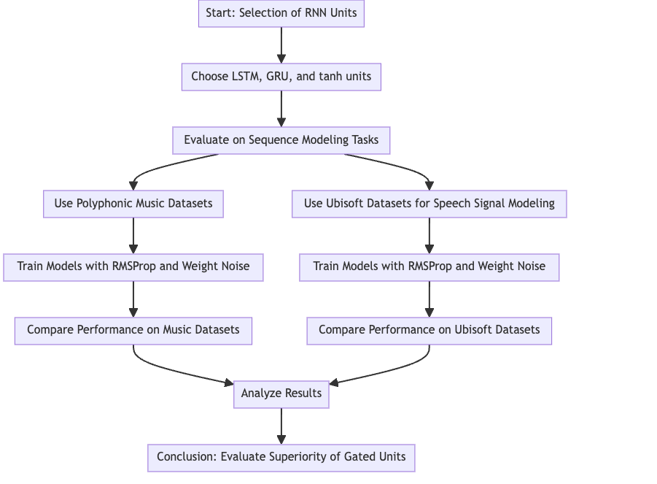
Their experiment
RMSprop (Root Mean Square Propagation) is an optimization algorithm

Slide 25
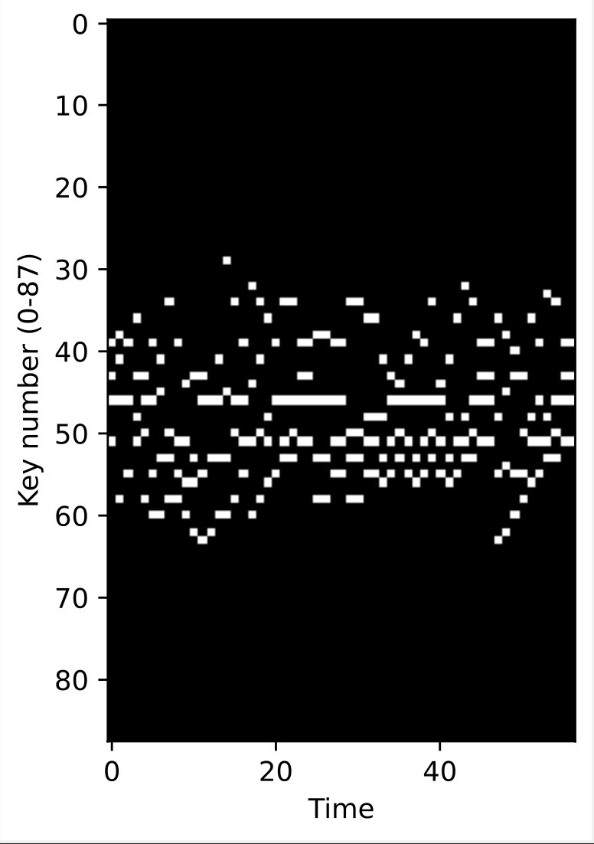
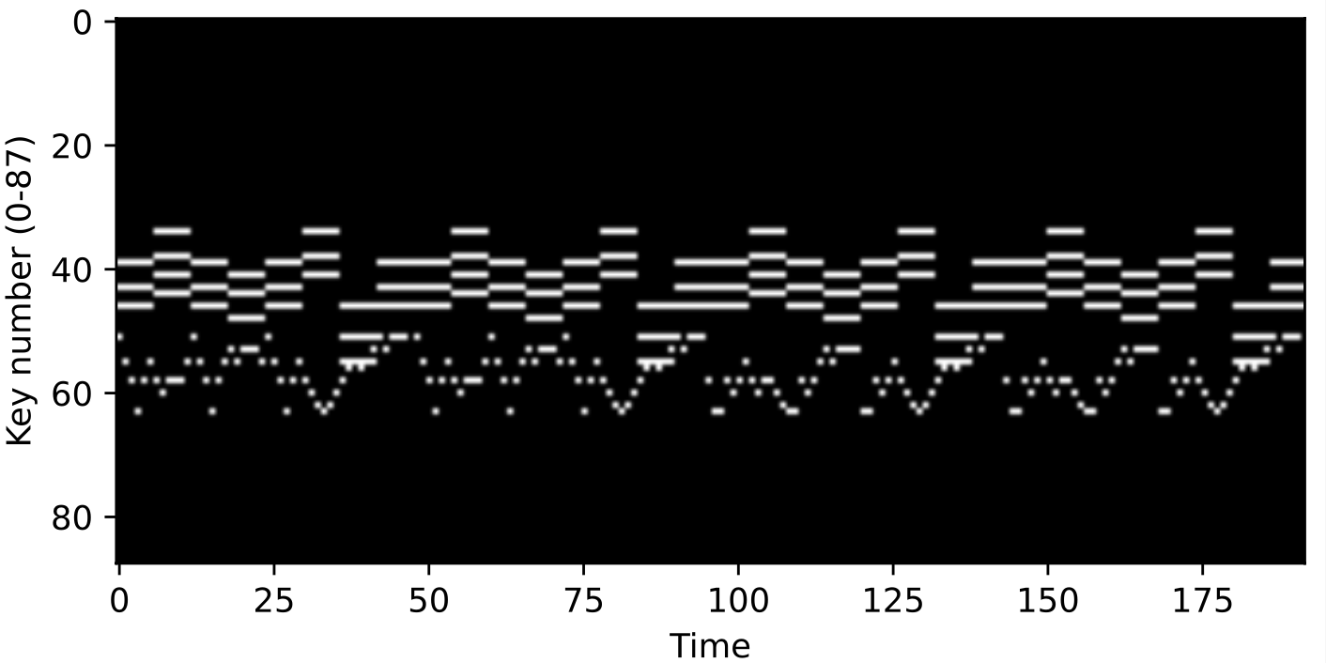

Data Set

Slide 26
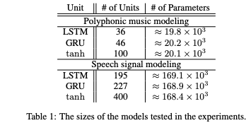
The Model
Three different recurrent neural networks (RNNs) were trained for each task: LSTM units (LSTM-RNN), GRUs (GRU-RNN), and tanh units (tanh-RNN).
The models were designed to have approximately the same number of parameters to ensure a fair comparison.

Slide 27
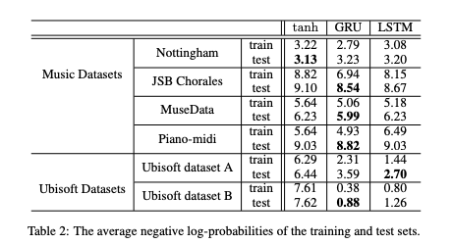

Slide 28
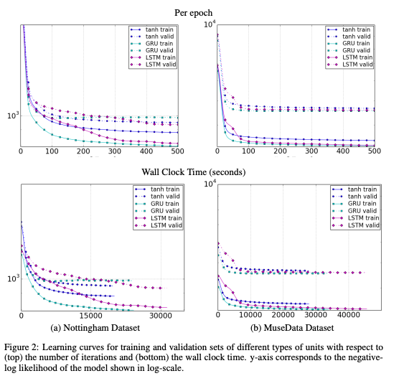
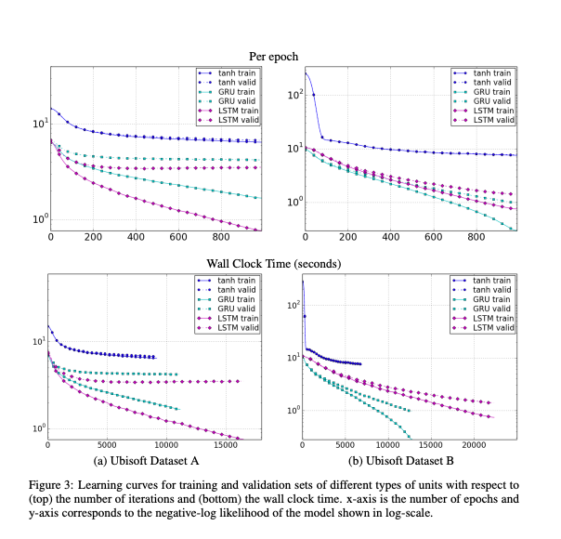
FIGURES

Slide 29
Key Takeaways
Gated units (LSTM ,GRU) demonstrated superior performance compared to traditional tanh units ,especially in more challenging tasks like raw speech signal modeling.
The choice between LSTM and GRU might be dataset and task-dependent, as both units showed competitive performance in different scenarios.

Slide 30
Reference
https://youtu.be/S7oA5C43Rbc?feature=shared

Slide 31
Thank you

